Slide 1
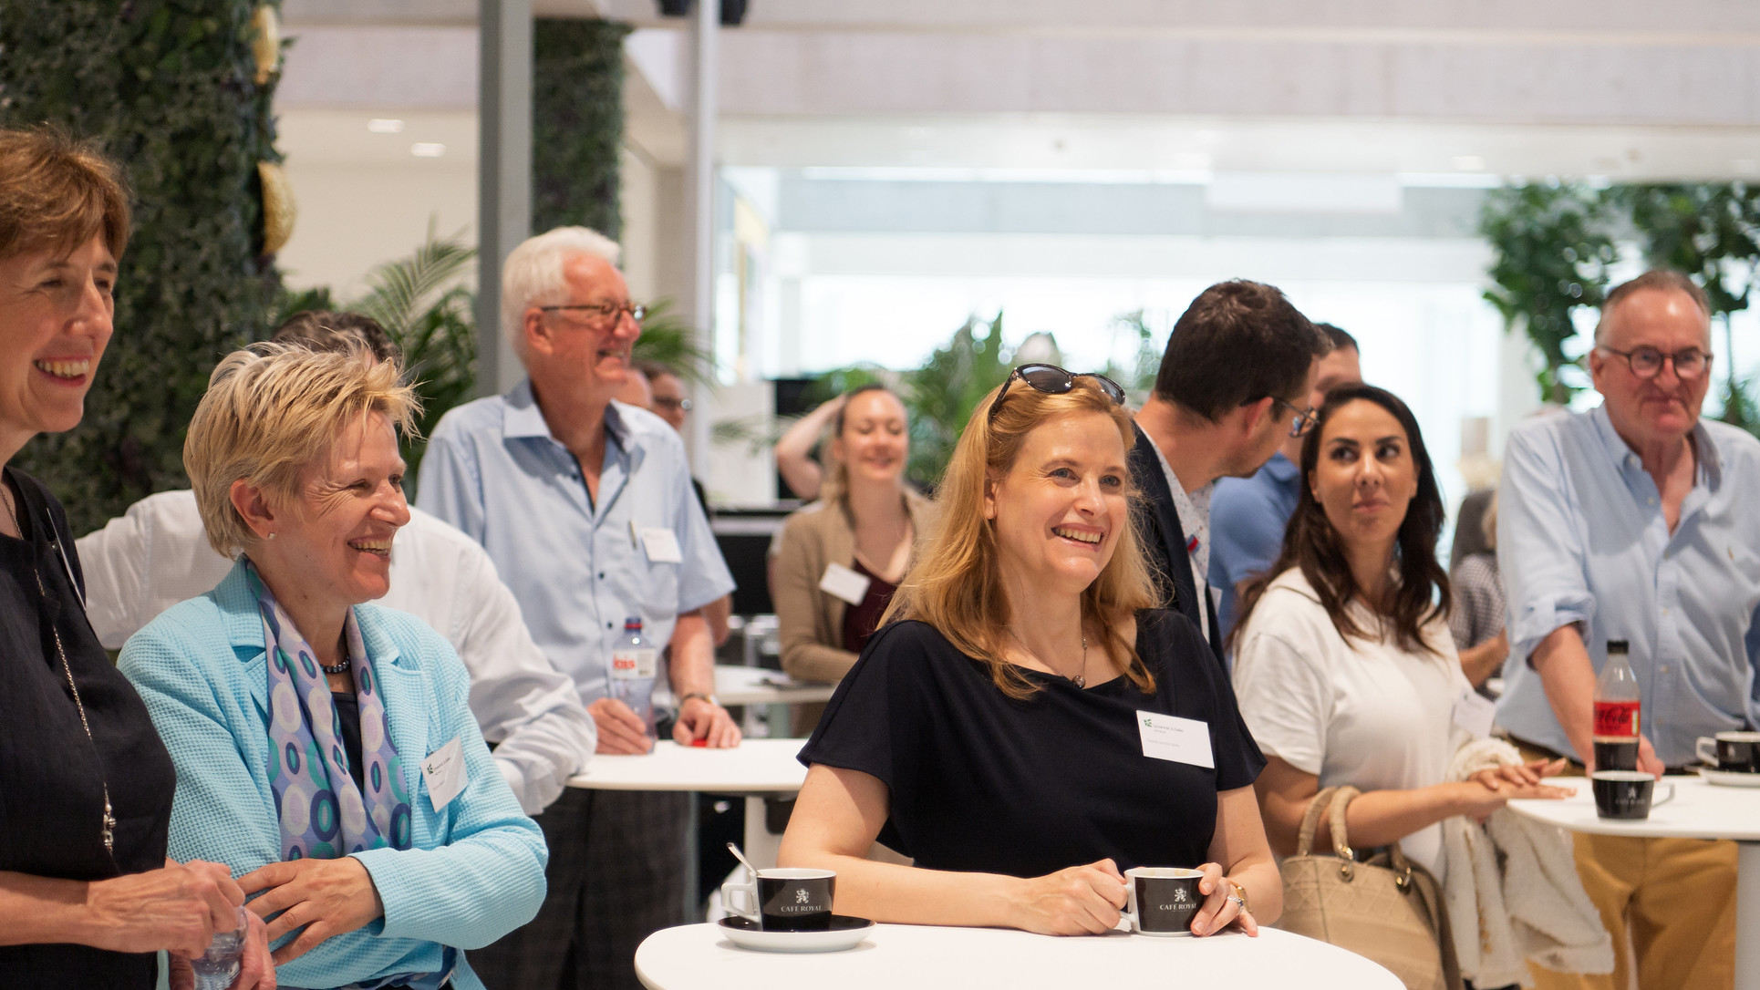


Slide 2
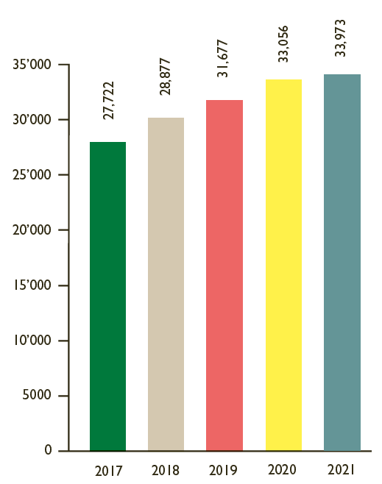
HSG Alumni
Over 180 HSG Alumni Clubs on five continents
HSG Alumni is the official alumni organisation of the University of St.Gallen. Since 2017, the number of HSG Alumni members has risen from 27,722 to 33,973. HSG Alumni is regarded as one of Europe’s largest and most professional alumni organisations.
More about HSG Alumni

Slide 3




HSG Alumni
Our vision
We aim to foster ties among current and former students, as well their relations and exchange with their University, and to promote lifelong learning and an all-round exchange of experience. Furthermore, we aim to support the University financially in teaching, research and executive education.
Brainfood
Volunteering
Emotion
Giving
Enabling live-long-learning through innovative peer-to-peer learning
journeys.
Building bridges between university, students and alumni through shared experiences.
Activating and engaging our community through inspiring events & communication.
Establishing a giving-back-culture through shared donation campaigns with the HSG foundation.

Slide 4
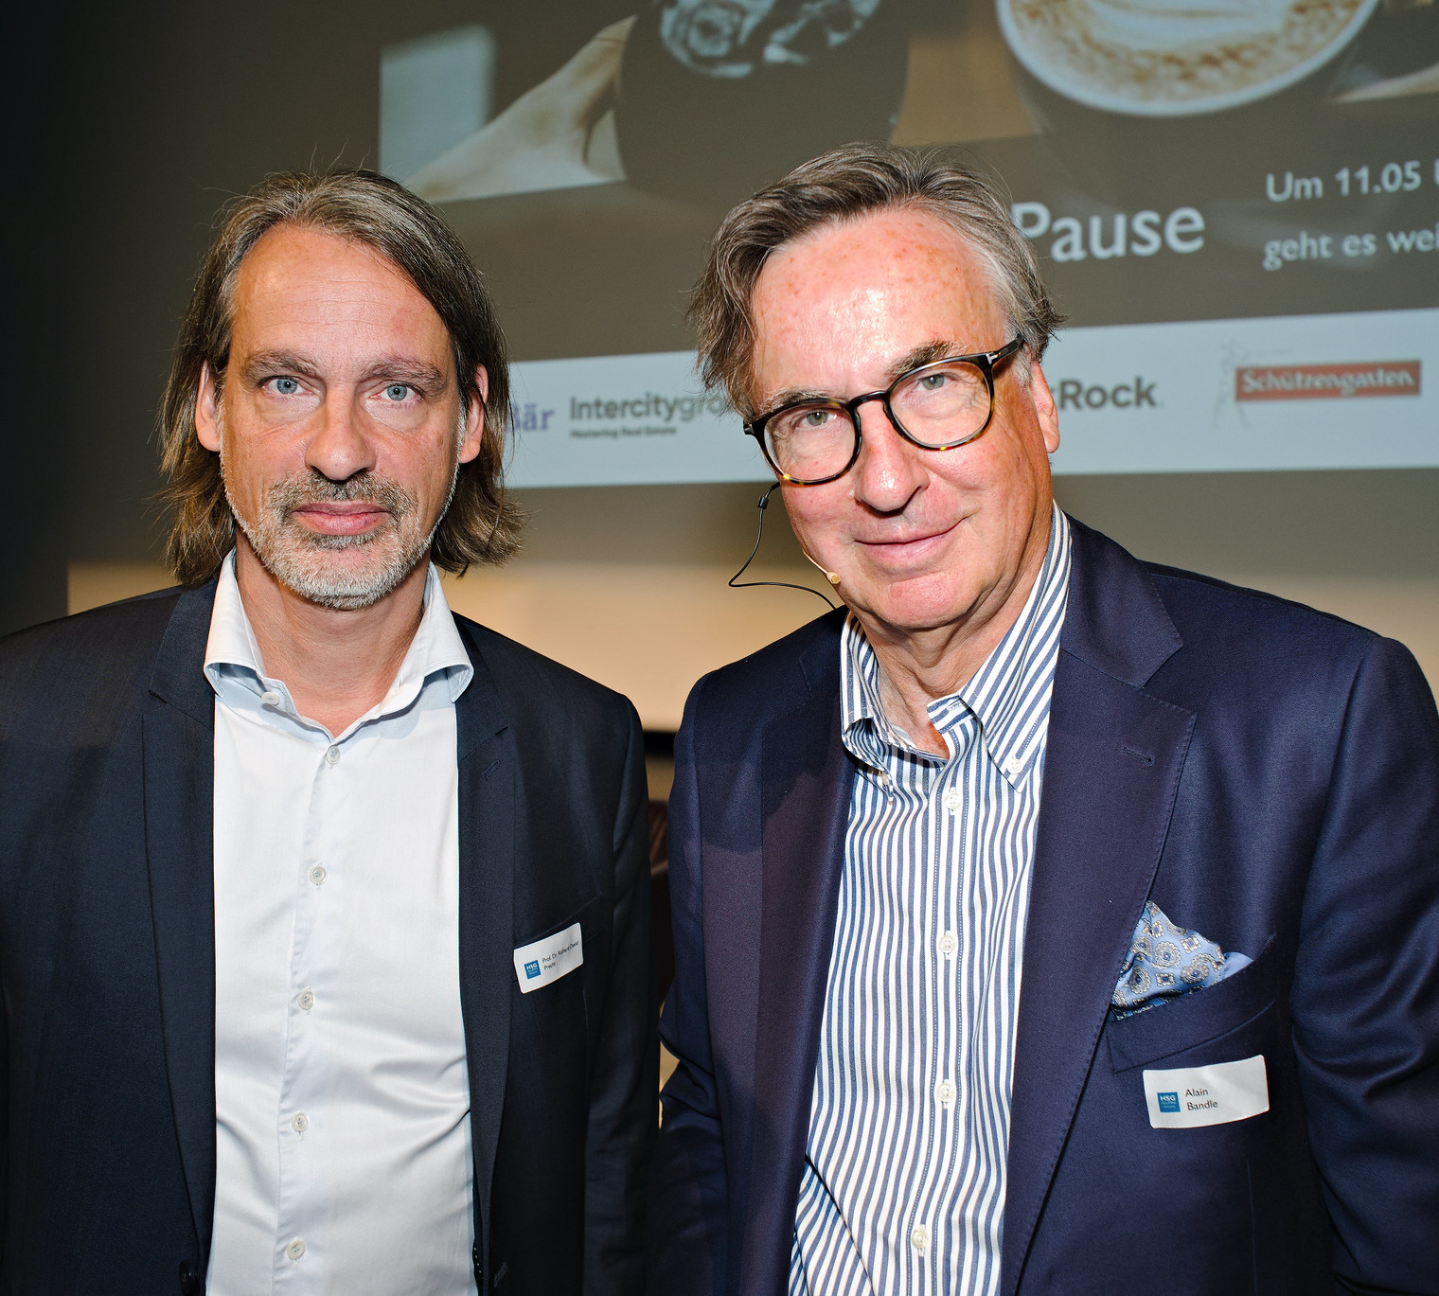
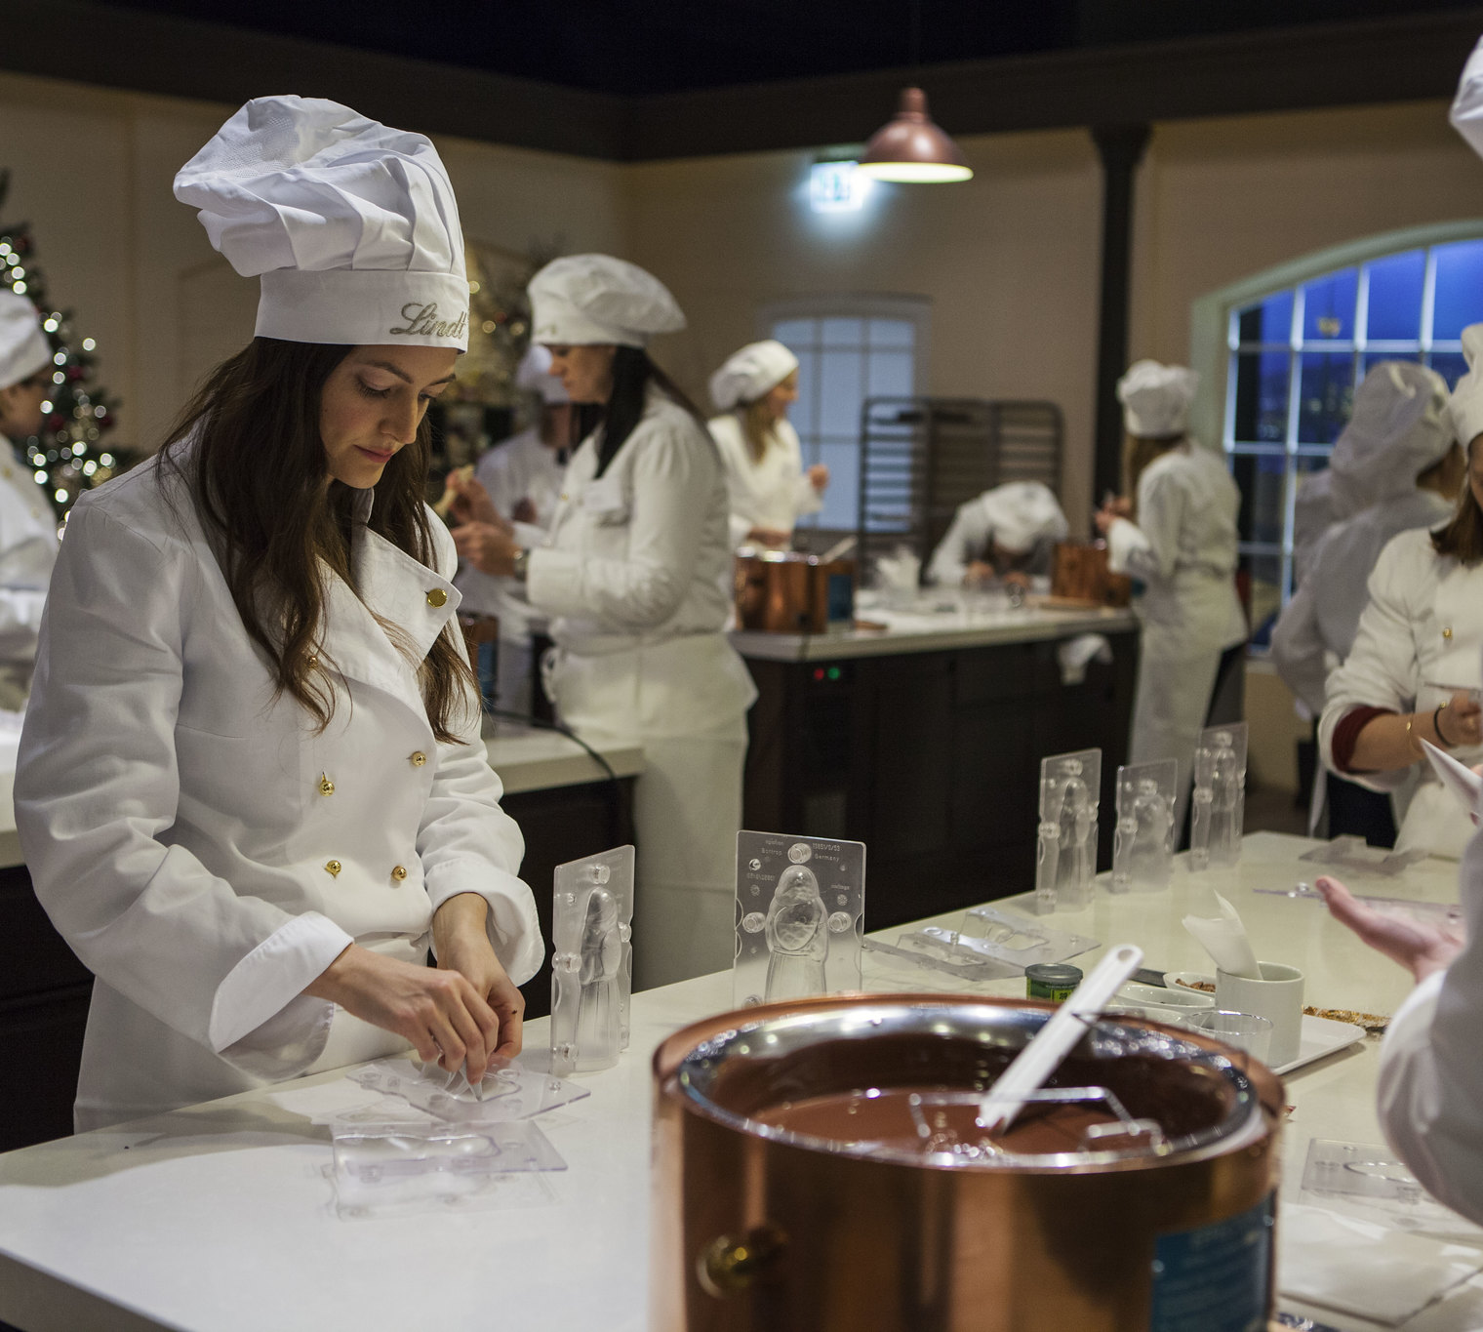

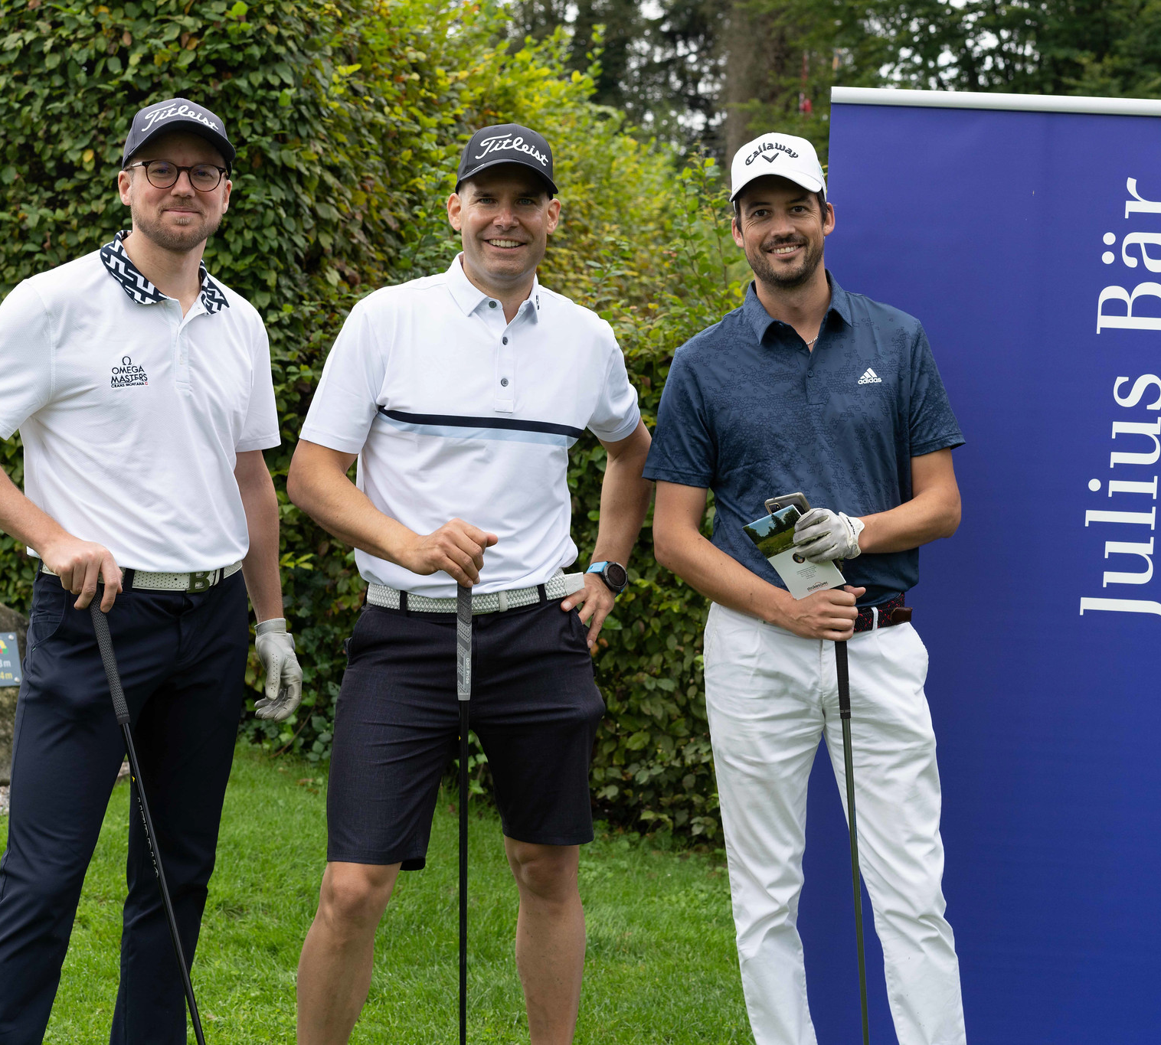
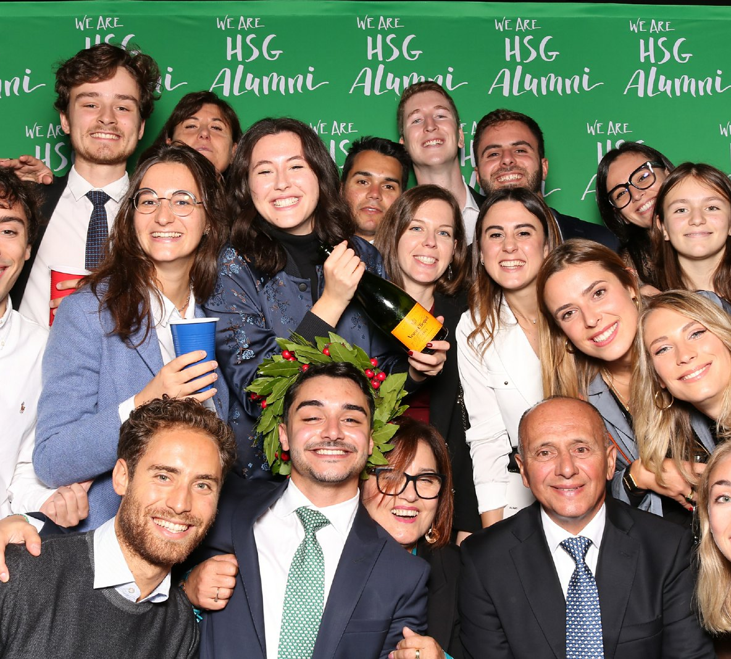
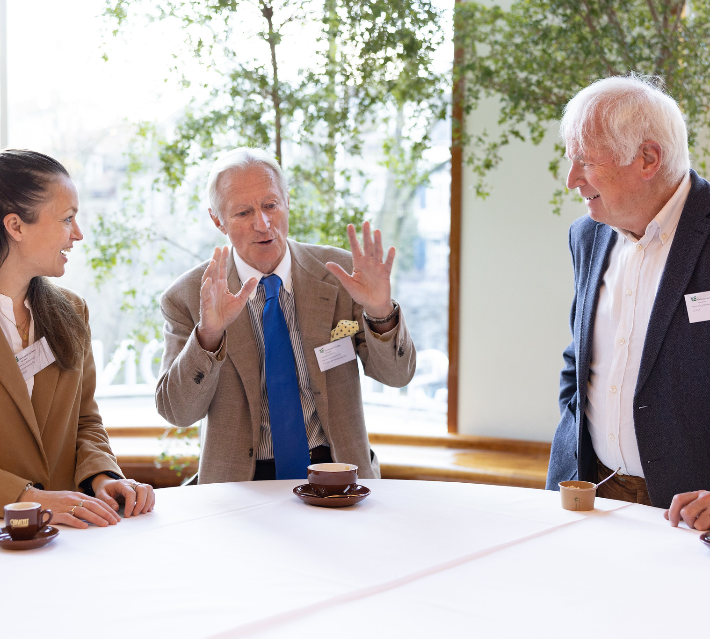
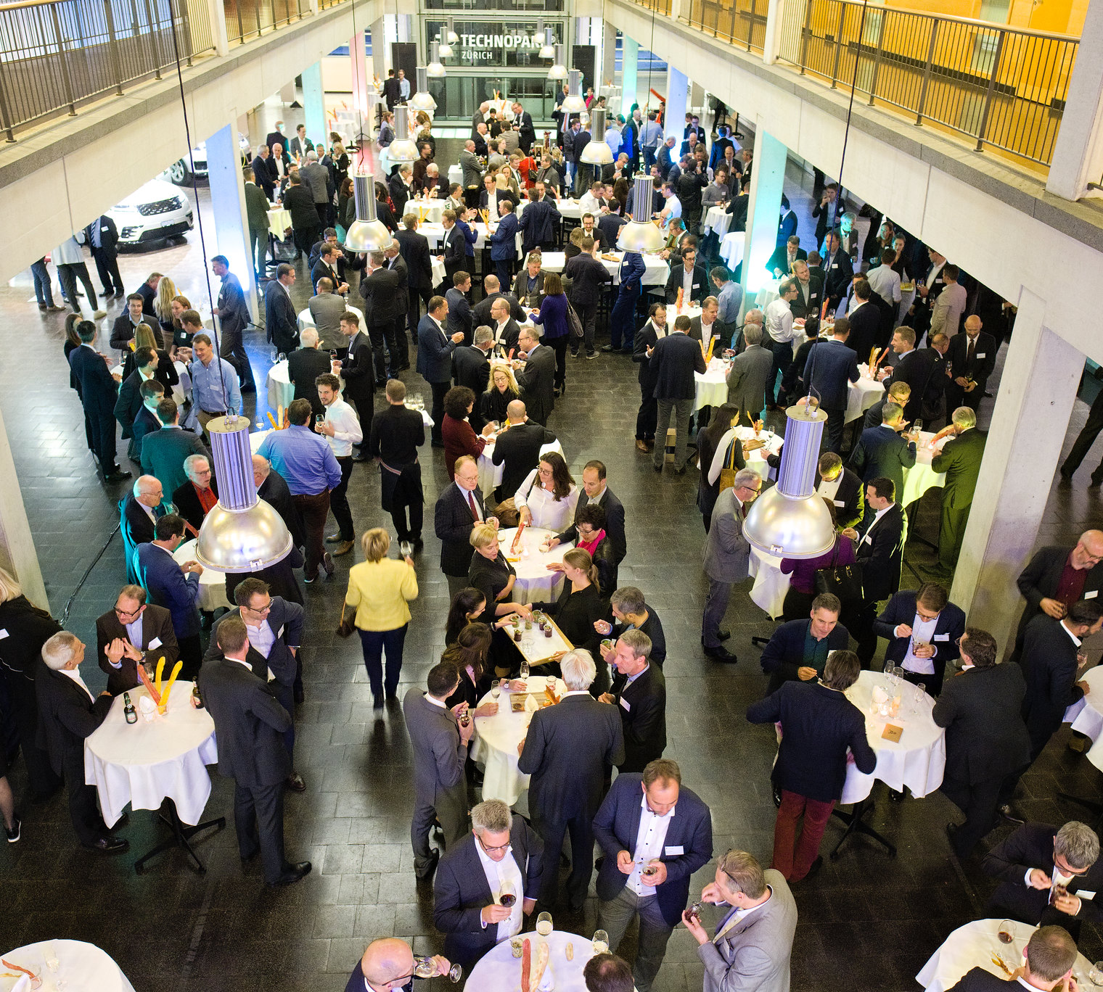
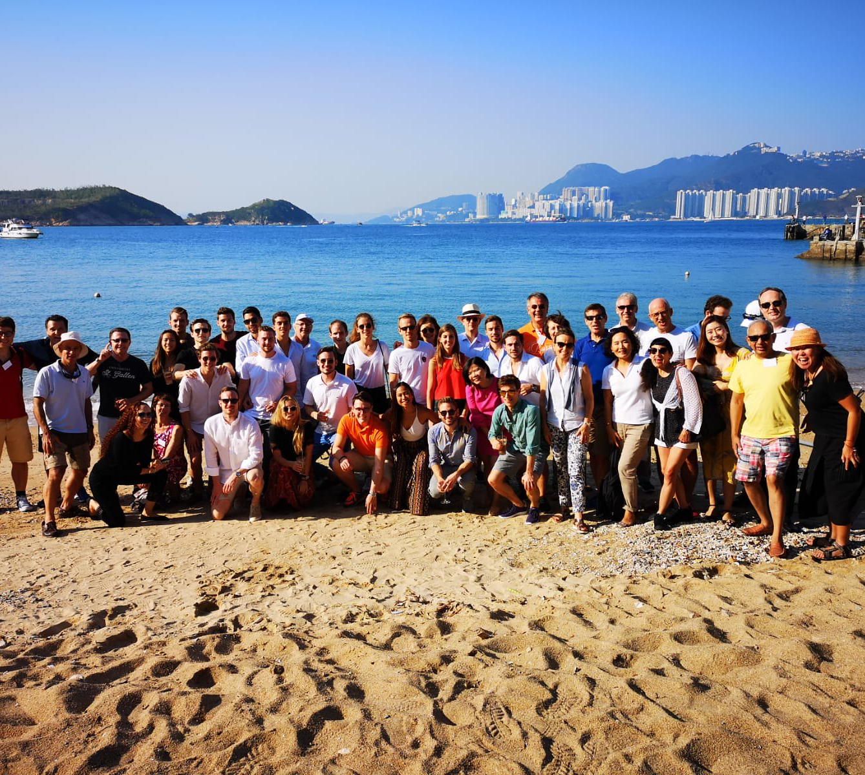
We are HSG Alumni
350 events each year

Slide 5
Information about the Club
Members
Activities

Slide 6
Information about the Activity/Event
Where
When (Date, Schedule of the Event)
Who (Participants, Speakers, organisational committee)
What (Topic)
Why

Slide 7
Mood pictures from previous events
https://www.flickr.com/photos/hsgalumniofficial/albums/

Slide 8
„Club name“
Sponsoring packages
Bronze CHF xxx |  | Silver CHF xxx |  | Gold CHF xxx
xxx |  | xxx |  | xxx
xxx |  | xxx |  | xxx
 |  | xxx |  | xxx
 |  | xxx |  | xxx
 |  |  |  | xxx
 |  |  |  | xxx

Slide 9
„Club name“
Your benefits as a sponsor
Brand transfer
Target group
Position your brand with renowned and high-profile brands like HSG, HSG Alumni and University of St.Gallen.
Access to an influential target group: 33,000 alumni, mostly in middle or higher management positions, 80% from Switzerland.
01
02
Networking
Tailored
Expand your own network during the xxx event.
04
03
Prominent and tailor-made appearance, based on our sponsoring packages.
Go to membership structure

Slide 10
Thank you.
Name
Email
Telephone
Akkreditierungen

